Slide 1
BRANCH : ECE
SEMESTER: 6th
MICROWAVE ENGINEERING

Slide 2
Table of Contents
High Frequency Transmission lines and Wave guides : The Lumped –Element Circuit model for a Transmission line. Wave propagation. The lossless line. Field Analysis of Co-ax Transmission Lines. R, L. C. G parameters of Co-ax& Two wire Transmission Lines. Terminated lossless transmission line. Transmission line as circuit element. The Smith Chart. Solution of Transmission line problems using Smith Chart. Single Stub and Double Stub matching. Lowloss line.
Wave guides : Rectangular waveguide, Field solution for TE and TM modes, Field patterns power flow through waveguide. Attenuation due to conductor and dielectric losses. Design of Rectangular waveguide to support Dominant TE10 only. manager.
TEM mode in Co-ax line. Cylindrical waveguide - Dominant Mode. Design of Cylindrical Waveguide to support Dominant TE11 mode. Microwave Resonator : Rectangular Waveguide Cavities. Resonant frequencies and of Cavity Supporting. Dominant mode only. Excitation of waveguide and Resonators (in princle only) Waveguide Components: Power Dividers and Directional Couplers : Basic Properties. The T-Junction Power Divider. Waveguide Directional Couplers. Fixed and Precision Variable Attenuator. Ferrite, Fermle Isolator . Principle of Operationing.
01
02

Slide 3
Table of Contents
03 Principle of Operation as an amplifier at high frequency, HEMT Amplifier, Concept of Doherty Amplifier and its use at high frequency, Gunn Oscillator Principle and performance Simple Analysis Electron – field interaction, Mixer: Linear Mixer Operation, active devices to use as mixer . Marketing strategy of small scale units- elements in marketing mix segmentation, product life cycles, pricing, distribution channels, export promotion and institutional support for marketing and exports.
04 Microwave Antennas: Horn Antennas : E-And H- Plane Horns. Radiation Patterns. Pyramidal Horn. Gain of Horn Antenna. Paraboloid Reflector Antenna – Simple Analysis , Radiation Pattern in principal Planes. Gain and Bandwidth of Reflector Antenna. Microwave Propagation : Line of sight propagation. Attenuation of Microwaves by Atmospheric gases, Water Vapour & Precipitates. Microwave Measurement : Measurement of Admittance . Measurement of Gain of a Horn Antenna.

Slide 4
MODULE-01

Slide 5
To discuss:
The Lumped –Element Circuit model for a Transmission line. Wave propagation.
The lossless line. Field Analysis of Co-ax Transmission Lines. R, L. C. G parameters of Co-ax& Two wire Transmission lines.
Terminated lossless transmission line. Transmission line as circuit element. The Smith Chart. Solution of Transmission line problems using Smith Chart .
Single Stub and Double Stub matching. Lowloss line .
Rectangular waveguide, Field solution for TE and TM modes, Field patterns power flow through waveguide.
Attenuation due to conductor and dielectric losses. Design of Rectangular waveguide to support Dominant TE10 only

Slide 6
What is a microwave?
Microwave is a form of electromagnetic radiation with wavelengths ranging from about one meter to one millimeter corresponding to frequencies between 300 MHz and 300 GHz respectively. ... A more common definition in radio-frequency engineering is the range between 1 and 100 GHz (wavelengths between 0.3 m and 3 mm.

Slide 7
Transmission line

Slide 26
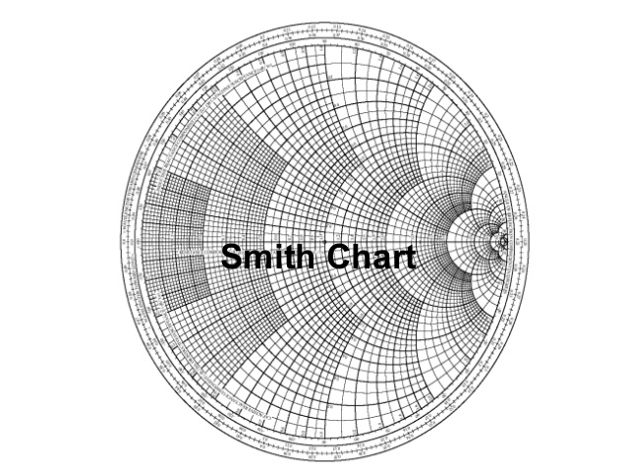

Slide 33
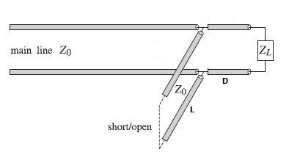
stub matches are widely used to match any complex load to a transmission line. They consist of shorted or opened segments of the line, connected in parallel or in series with the line at a appropriate distances from the load.
.

Slide 34
Double stub matching
A double-stub matching network matches a complex load impedance (Zload) to a desired complex input impedance (Zin) using two shunt stubs and a connecting line. ... For example, if stub 1 is open circuited, the solution for which stub 1 must realize a capacitive reactance is chosen.

Slide 35
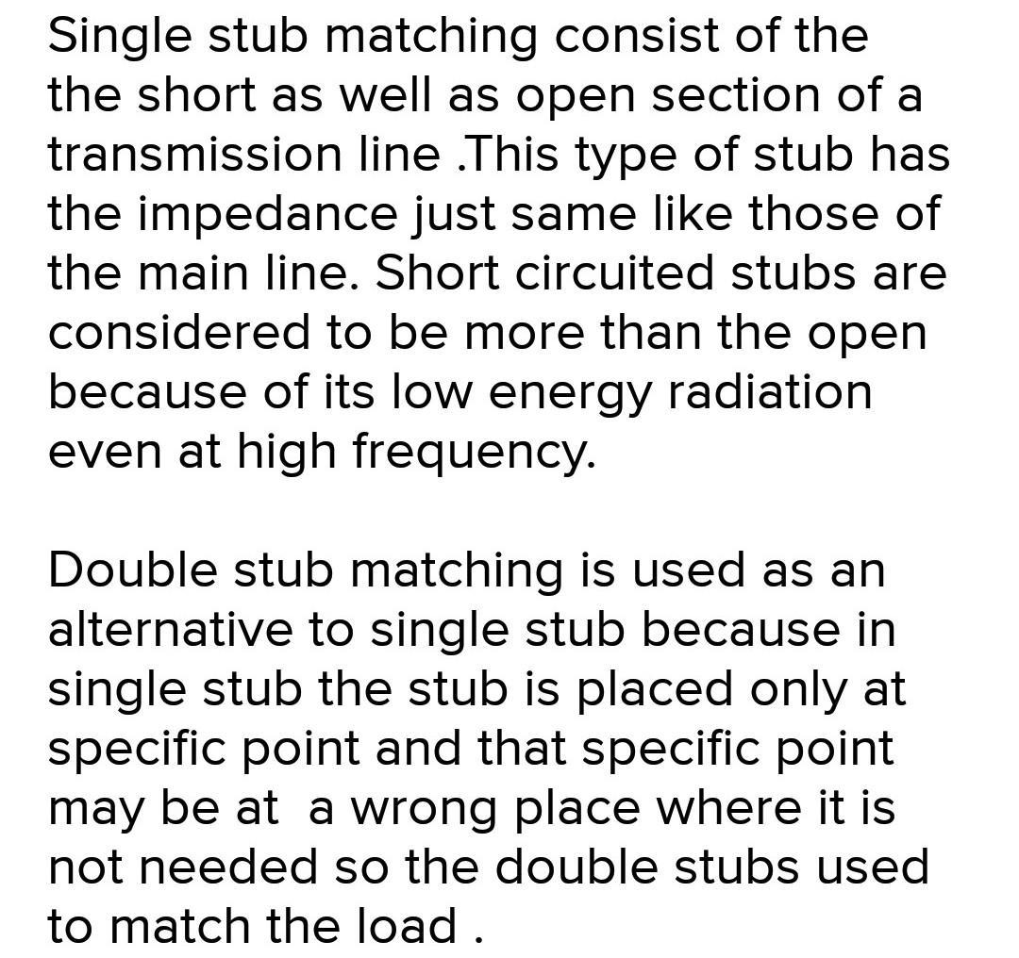

Slide 46
SHORT QUESTION WITH ANSWER
1. Easily adjustable tuning component in a waveguide is (A) plunger (B) plunger and stub (C) screw (D) both (a) and (c)
Answer: plunger and stub
2. A Klystron is a cavity acting as buncher and catcher is used as microwave tube for (A) Guiding waves (B) Velocity modulation (C) Frequency modulation (D) impedance matching
Answer: Velocity modulation

Slide 47
3. Which of the following sinusoidal oscillator is preferred for microwave frequencies? (A) resonant circuit oscillator (B) RC phase shift oscillators (C) negative resistance oscillators (D) all of the above
Answer: negative resistance oscillators
4. The negative resistance in Gunn diode is due to (A) electron transfer to a less mobile energy level (B) high reverse bias (C) electron domain formation at the junction (D) tunneling across the junction
Answer: electron domain formation at the junction
5. TWT is basically (A) an oscillator (B) tuned amplifier (C) wideband amplifier (D) an audio amplifier
Answer: wideband amplifier

Slide 48
6. An attenuator is used with TWT to (A) prevent oscillations (B) increase gain (C) prevent saturation (D) help bunching
Answer: prevent oscillations
7. For handling large microwave power, the best medium is (A) coaxial line (B) rectangular waveguide (C) stripline (D) circular wave guide
Answer: rectangular waveguide
8. Due to curvature of earth, microwave repeaters are placed at distance of about (A) l0 Km (B) 50 Km (C) 200 Km (D) 500 Km
Answer: 50 Km

Slide 49
9. The Biggest Disadvantage the IMPATT Diode has is its (A) Low Efficiency (B) High Noise (C) Low BW (D) Inutility to provide Pulse Operation
Answer: High Noise
10. Vacuum Tube Eventually Fall at Microwave Frequencies Because of their (A) Inter Electrode Capacitance (B) Small Series inductance (C) Large Shunt Capacitance (D) Short Transit Time
Answer: Inter Electrode Capacitance
11. TWT uses a helix (A) To reduce the axial velocity of RF field (B) To increase the efficiency (C) To reduce the noise (D) To ensure broad band operation
Answer: To reduce the axial velocity of RF field

Slide 50
12. A waveguide acts as a (A) Low pass filter (B) Band pass filter (C) High pass filter (D) All of the above
Answer: High pass filter
13. The MASER occurs in the portion of electromagnetic spectrum is (A) Infrared (B) UV (C) Visible (D) RF
Answer: Infrared
14. Which of the following diodes has a p-n-i-p structure? (A) TRAPATT (B) IMPATT (C) BARITT (D) Gun diode
Answer: BARITT

Slide 51
15. A laser may be internally modulated at a frequency equal to the frequency separation between axial modes. This phenomenon is termed as (A) mode locking (B) pad locking (C) locking (D) none of the above
Answer: mode locking
16. A reflex Klystron is a (A) Microwave oscillator (B) Microwave amplifier (C) Both as Microwave amplifier and oscillator (D) A high gain cavity
Answer: Microwave oscillator
17. Ionospheric propagation is not possible for microwaves because (A) Microwaves will be fully absorbed by the ionospheric layers (B) There will be an abrupt scattering in all directions (C) Microwave will penetrate through the ionospheric layers (D) There will be dispersion of microwave energy
Answer: Microwave will penetrate through the ionospheric layers

Slide 52
18. HEMT used in microwave circuit is a (A) Source (B) High power amplifier (C) Detector (D) Low noise Amplifier
Answer: Low noise Amplifier
19. Most of the power measuring microwave devices measure (A) Average power (B) Peak power (C) Instantaneous power (D) None of these
Answer: Average power
20. A disadvantage of microstrips with respect to stripline circuit is that the former: (A) Do not let themselves to be printed-circuits (B) Are more likely to radiate (C) Are bulkier (D) Are more expensive and complex to manufacture
Answer: Are more expensive and complex to manufacture

Slide 53
MODULE-02

Slide 54
To discuss:
TEM mode in Co-ax line. Cylindrical waveguide - Dominant Mode. Design of Cylindrical Waveguide to support Dominant TE11 mode. .
Microwave Resonator : Rectangular Waveguide Cavities. Resonant frequencies and of Cavity Supporting. Dominant mode only. Excitation of waveguide and Resonators (in princple only ).
Waveguide Components: Power Dividers and Directional Couplers : Basic Properties. The T-Junction Power Divider. Waveguide Directional Couplers. Fixed and Precision Variable Attenuator. Ferrite.
Fermel Isolator . Principle of Operationing.

Slide 80
Short questions with answer
1. Slotted line is a transmission line configuration that allows the sampling of: a) electric field amplitude of a standing wave on a terminated line b) magnetic field amplitude of a standing wave on a terminated line c) voltage used for excitation d) current that is generated by the source
Answer: a
2. A slotted line can be used to measure _____ and the distance of _____________ from the load. a) SWR, first voltage minimum b) SWR, first voltage maximum c) characteristic impedance, first voltage minimum d) characteristic impedance, first voltage maximum
Answer: a

Slide 81
3. If the standing wave ratio for a transmission line is 1.4, then the reflection coefficient for the line is: a) 0.16667 b) 1.6667 c) 0.01667 d) 0.96
Answer: a
4. If the reflection coefficient of a transmission line is 0.4, then the standing wave ratio is: a) 1.3333 b) 2.3333 c) 0.4 d) 0.6
Answer: b
5. Expression for ϴ means phase angle of the reflection co efficient r=|r|-e^jθ, the phase of the reflection co-efficient is:
a) θ=2π+2βL_{min} b) θ=π+2βL_{min} c) θ=π/2+2βL_{min} d) θ=π+βL_{min}
Answer: b

Slide 82
6. In the expression for phase of the reflection coefficient, L_{min} stands for : a) distance between load and first voltage minimum b) distance between load and first voltage maximum c) distance between consecutive minimas d) distance between a minima and immediate maxima
Answer: a
7. If SWR=1.5 with a wavelength of 4 cm and the distance between load and first minima is 1.48cm, then the reflection coefficient is: a) 0.0126+j0.1996 b) 0.0128 c) 0.26+j0.16 d) none of the mentioned
Answer: a
8. If the characteristic impedance of a transmission line 50 Ω and reflection coefficient is 0.0126+j0.1996, then load impedance is: a) 47.3+j19.7Ω b) 4.7+j1.97Ω c) 0.26+j0.16 d) data insufficient
Answer: a

Slide 83
9. If the normalized load impedance of a transmission line is 2, then the reflection co-efficient is: a) 0.33334 b) 1.33334 c) 0 d) 1
Answer: a
10. A modern device that replaces a slotted line is: a) Digital CRO b) generators c) network analyzers d) computers
Answer: c

Slide 84
MODULE-03

Slide 85
To discuss:
Principle of Operation as an amplifier at high frequency, HEMT Amplifier,
Concept of Doherty Amplifier and its use at high frequency,
Gunn Oscillator Principle and performance Simple Analysis Electron – field interaction,
Mixer: Linear Mixer Operation, active devices to use as mixer

Slide 98
Short questions with answers
1. A cylindrical cavity resonator can be constructed using a circular waveguide. a) shorted at both the ends b) open at both the ends c) matched at both the ends d) none of the mentioned
Answer: a
2. The dominant mode in the cylindrical cavity resonator is TE₁₀₁ mode. a) true b) false
Answer: b
3. Circular cavities are used for microwave frequency meters. a) true b) false
Answer: a

Slide 99
4. The mode of the circular cavity resonator used in frequency meters is: a) TE₀₁₁ mode b) TE₁₀₁ mode c) TE₁₁₁ mode d) TM₁₁₁ mode
Answer: a
5. The propagation constant of TEmn mode of propagation for a cylindrical cavity resonator is: a) √ (k²-(p_{nm}/a)²) b) √ p_{nm}/a c) √ (k²+(p_{nm}/a)²) d) none of the mentioned
Answer: a
6. A circular cavity resonator is filled with a dielectric of 2.08 and is operating at 5GHz of frequency. Then the wave number is: a) 181 b) 151 c) 161 d) 216
Answer: b

Slide 100
7. Given that the wave number of a circular cavity resonator is 151 (TE₀₁₁ mode), and the length of the cavity is twice the radius of the cavity, the radius of the circular cavity operating at 5GHz frequency is: a) 2.1 cm b) 1.7 cm c) 2.84 cm d) insufficient data
Answer: d
8. The loss tangent for a circular cavity resonator is 0.0004.Then the unloaded Q due to dielectric loss is: a) 1350 b) 1560 c) 560 d) 2500
Answer: d
9. A circular cavity resonator has a wave number of 151, radius of 2.74 cm, and surface resistance of 0.0184Ω. If the cavity is filled with a dielectric of 2.01, then unloaded Q due to conductor loss is: a) 25490 b) 21460 c) 29390 d) none of the mentioned

Slide 101
Answer: c
10. If unloaded Q due to conductor loss and unloaded Q due to dielectric loss is 29390 and 2500 respectively, then the total unloaded Q of the circular cavity is: a) 2500 b) 29390 c) 2300 d) 31890
Answer: c

Slide 102
MODULE-04

Slide 103
To discuss:
Microwave Antennas: Horn Antennas : E-And H- Plane Horns. Radiation Patterns. Pyramidal Horn. Gain of Horn Antenna. Paraboloid Reflector Antenna – Simple Analysis , Radiation Pattern in principal Planes.
Gain and Bandwidth of Reflector Antenna. Microwave Propagation : Line of sight propagation. Attenuation of Microwaves by Atmospheric gases, Water Vapour & Precipitates.
Microwave Measurement : Measurement of Admittance . Measurement of Gain of a Horn Antenna.

Slide 110
Short questions with answer
1. In coupled line directional couplers, power from one line to another is transmitted through a microstrip line running between them. a) true b) false
Answer: b
2. The number of conductors used in the construction of coupled line couplers is fixed. a) true b) false
Answer: b
3. The mode of propagation of propagation supported by coupled line couplers is: a) TM mode b) TE mode c) TEM mode d) quasi TEM mode
Answer: c

Slide 111
4. Coupled line couplers are: a) symmetric couplers b) asymmetric couplers c) in phase couplers d) type of hybrid coupler
Answer: a
5. For coupled line coupler, if the voltage coupling factor is 0.1 and the characteristic impedance of the microstrip line is 50 Ω, even mode characteristic impedance is: a) 50.23 Ω b) 55.28 Ω c) 100 Ω d) 80.8 Ω
Answer: b
6. If the coupling coefficient of a coupled line coupler is 0.1 and the characteristic impedance of the material is 50 Ω, then the odd mode characteristic impedance is: a) 45.23 Ω b) 50 Ω c) 38 Ω d) none of the mentioned
Answer: a

Slide 112
8. Multisection couplers have a very narrow operational bandwidth which is a major disadvantage. a) true b) false
Answer: b
9. Three section binomial couplers have very low directivity as compared to other coupler designs. a) true b) false
Answer: b
10. The capacitance per unit length of broadside parallel lines with width W and separation d is: a) ∈W/d b) ∈d/W c) dW/∈ d) none of the mentioned
Answer: a

Slide 113
REFERENCES Agrawal, D. K., Y. Fang, D. M. Roy, and R. Roy. 1992. Fabrication of Hydroxyapatite Ceramics by Microwave Processing. Pp. 231—236 in Materials Research Society Symposium Proceedings, Vol. 269, Microwave Processing of Materials III. R. L. Beatty, W. H. Sutton, and M. F. Iskander, eds. Pittsburgh, Pennsylvania: Materials Research Society. Agrawal, R. J. and L. T. Drzal. 1989. Effects of Microwave Processing on Fiber—Matrix Adhesion in Composites. Journal of Adhesion 29(1-4):63—79. Ahmad, I., R. Dalton, and D. Clark. 1991. Unique Application of Microwave Energy to the Processing of Ceramic Materials. Journal Microwave Power and Electromagnetic Energy. 26(3): 128—138.

Slide 114
THANK YOU

